Slide 1
GOING OUT OF THE GREAT RECESSION? CONTRAST BETWEEN THE UNITED STATES AND EUROPE:
PROPOSED WORK FROM ECONOMIC HISTORY, 1960-2014
Carles Manera
Universitat de les Illes Balears
(carles.manera@uib.es)
Ferran Navinés Badal
DGUR. Govern Illes Balears
(fnavines@dgrdi.caib.es)
Javier Franconetti Manchado
Universitat de les Illes Balears
(jfranconetti@economistas.org

Slide 2
1.
Comparing to learn
Work on the Great Recession are already abundant, although very uneven in content. Economists and economic historians professionally nature face of a crisis that is encouraging, as was the case with the Great Depression, not only concerning causes and effects, "technical" but also a deep ideological component analysis, one way or another moves in direct and indirect way to the political sphere.

Slide 3
The arrogance of the Economy; modesty of Economic History
The Great Recession, as before the Great Depression should suggest that economic epistemology must deal with higher doses of humility and modesty on the part of all economists, including mainstream.
Notes:
In this regard, recognize doubts and uncertainties, not camouflage a hollow but bombastic language, should be a line of intellectual behavior by teachers and researchers who work in universities, research centers and institutions of all types, without neglecting naturally, the economic policy advice.

Slide 4
2.
USA to Europe
These basic assumptions are guiding our investigations into the Great Recession, which have already offered some results (Manera, 2012, 2015; Manera, Navinés, Franconetti, 2015). These are the main platform for new work projects, like the one shown below. We try, in this regard, to provide a concrete way of economic research from a detailed analysis of databases of public, available to researchers worldwide. We focus our arguments in selected economies in Europe (UK, Germany, France, Italy and Spain), which may be representative of what is happening in northern and southern Europe.
Notes:
Excluding Greece consider an extreme example of precisely the first conclusions we have reached. For the United States, which have worked in depth and we have provided concrete results (especially Manera, Navinés, Franconetti, 2015), serves as an essential reference for our new methodological analysis.

Slide 5
Scheme
Our research is organized as follows. A first section details the methodology followed coordinates, taking, as was said, for the United States as a base. A second section presents four lines-force investigation relating to US and European economies considered. Finally, some initial conclusions to be better validated by further research, still under development are specified.
Notes:
In this presentation I will give a summary of our findings and refer the text for further development

Slide 6
3.
Sources
Databases of the Bureau of Economic Analysis (BEA) and the Bureau of Labor Statistics (BLS).
For Germany, AMECO publishes two series, the first starting in 1960-1991 under the title of "West Germany", which records the data of which was the Federal Republic of Germany; and another that goes from 1991 to 2015 under the name "Germany", which corresponds to Germany after unification. By 1991, both series share, has taken the value resulting from the arithmetic mean of both records.
Notes:
Another difference to note is that now for the European economies, and also for the United States, have worked with the base AMECO

Slide 7
Simple accounting identities, no econometric models: the basic operation
r= q · πk
r= rate of profit
q= share of national income surplus
πk= productivity of capital

Slide 8
Simple informations
r= E/K; Surplus of capital/Stock of capital
q= E/Y; Surplus of capital/National Income
πk= Y/K; National Income/Stock of capital

Slide 9
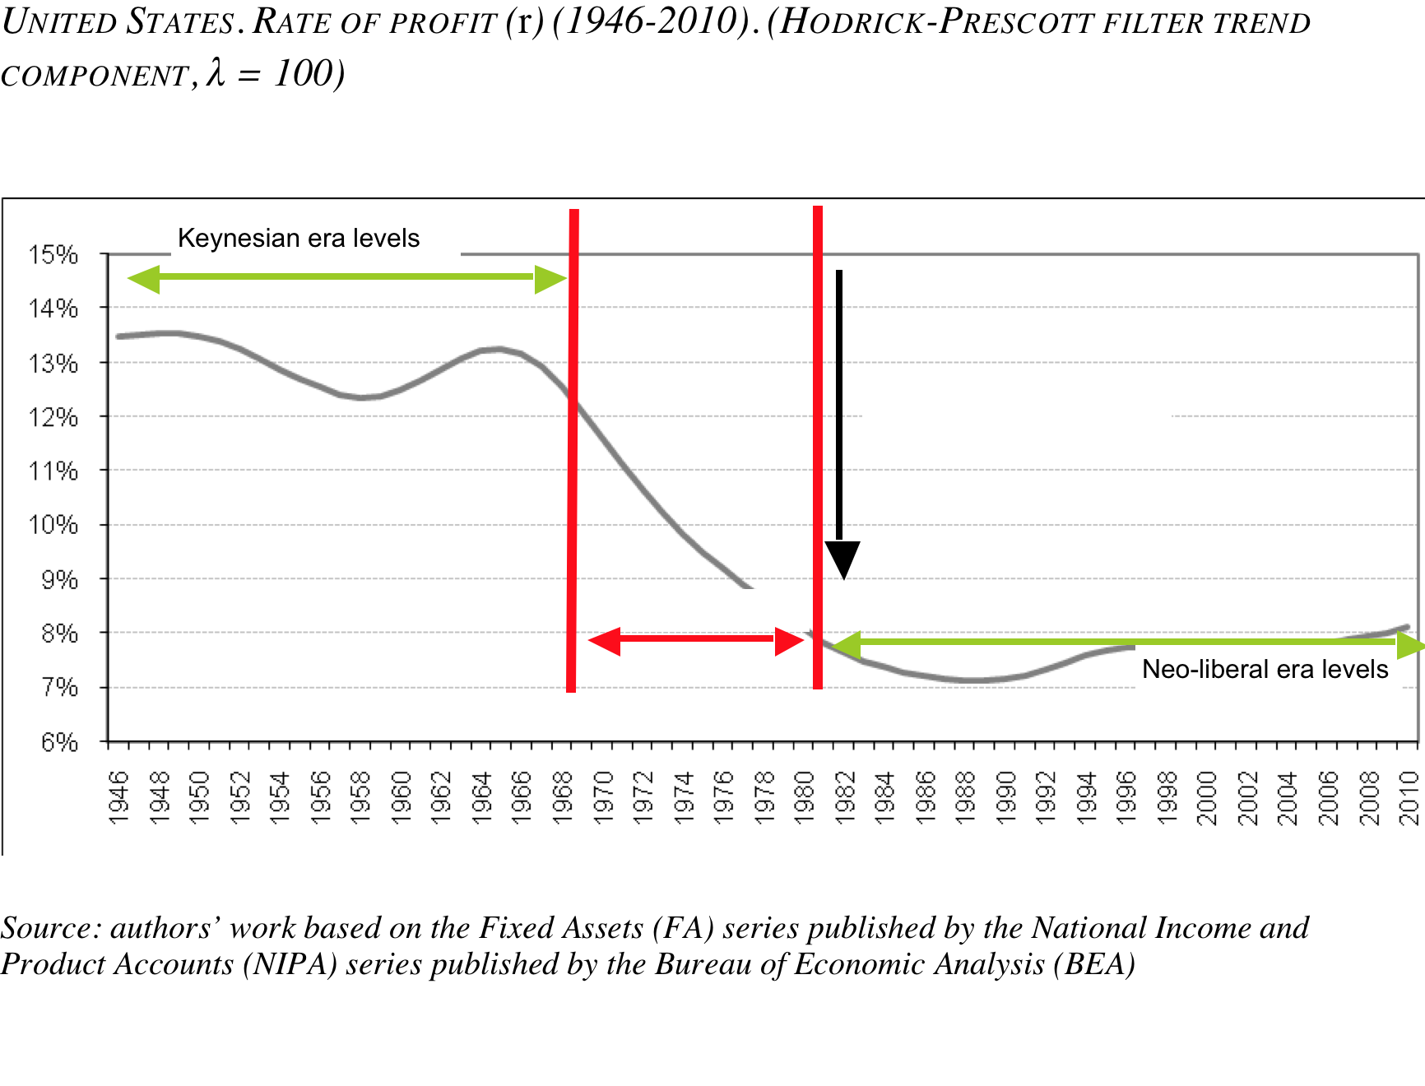
Changes between the Keynesian and neoliberal regulations…
Notes:
With changing regulation of Keynesianism to neoliberalism since 1980, there has been a substantial fall in the rate of profit of non-financial companies, which are representative of the productive economy, meet the growing financialization of corporate rest: in Specifically, half of the values achieved in the years of Keynesian regulation (1945-1973). This significant loss of profit level in this type of business is justified by a substantial loss of capital productivity, a trend that has tried to counter the neoliberal phase regulation by way of increasing inequality, which translates into an increase the significant share of gross operating surplus in national income, with the counterpart of a downward trend in the share of wages in national income

Slide 10
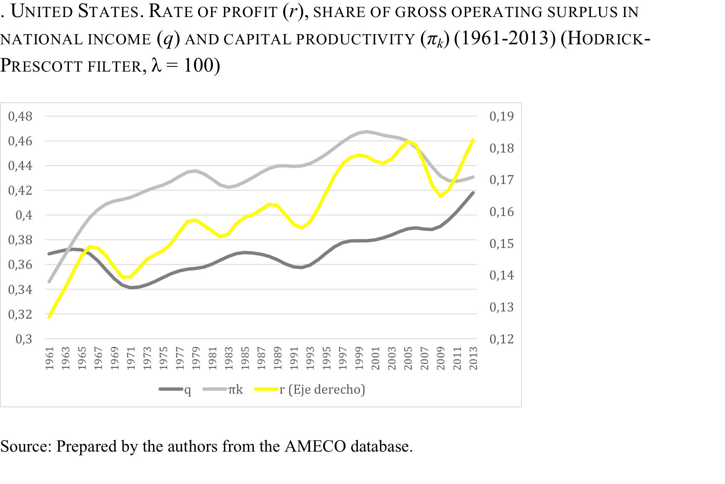
…but with different evolution on the european database

Slide 11
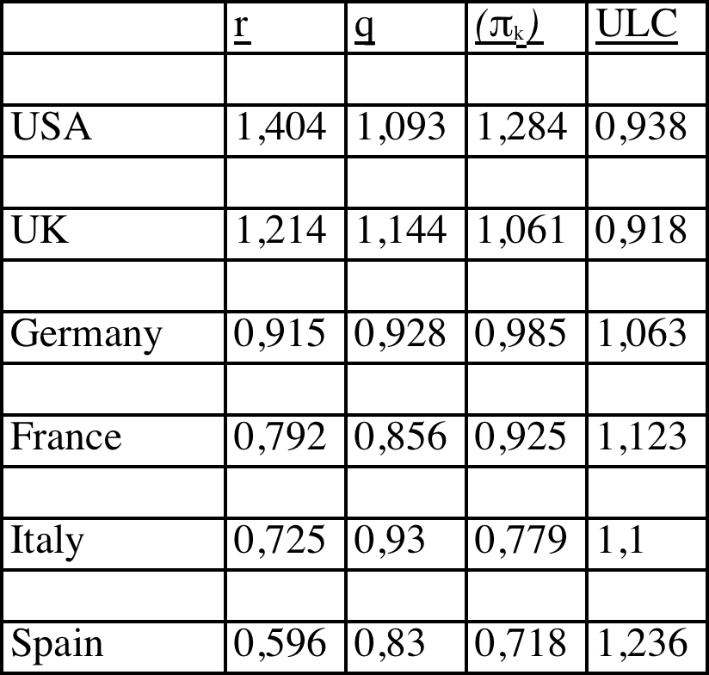
A/. Anglo-Saxon capitalism, European capitalism
Growth factors of the rate of profit (and) share surplus (q) capital productivity (πk) and unit labor costs (ULC) (1961-2013)
Source: from the AMECO database processing
Notes:
Economic differentiation: Anglo-Saxon capitalism, European capitalism. In the Anglo-Saxon model, the growth rate of profit (r) occurs as a result of controlling the unitaries labour costs, especially along the neoliberal phase, which explains the growth of the share of national income surplus (q ), with growth of productive capital efficiency measured by productivity growth (πk). By contrast, the continental European model no growth in its rate of profit; no progress is made in capital productivity (πk). In the Anglo-Saxon model, the United States has, compared to the UK, greater productive efficiency, reflected in the better performance of productivity of capital (πk), which allows to maintain a higher growth rate of profit (r) despite exercise less control over the unitaries labour costs. The other continental European countries analyzed detail a falling rate of profit (more pronounced in Spain, followed by Italy, France and Germany), explained both by falling of the share of national income surplus and the increase in unitaries labour costs (most evident in Spain ) and receding (πk).

Slide 12
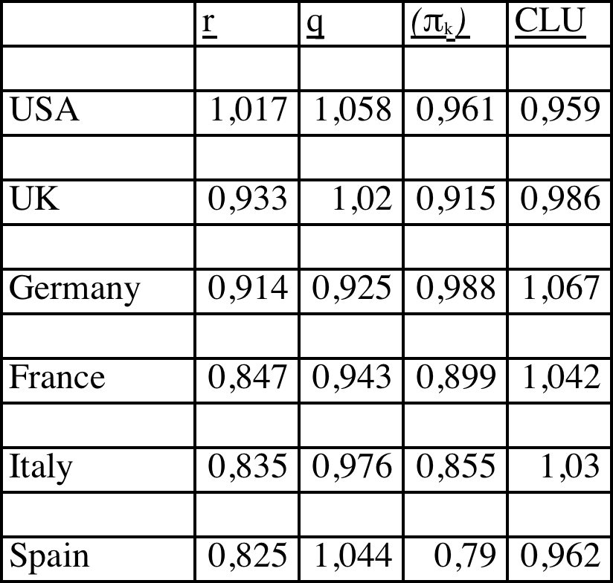
B/. Issue out of the crisis…
Growth factors of the rate of profit (r) share surplus (q) capital productivity (πk) and unit labor costs (ULC) (2007-2013)
Notes:
False start of the crisis, which occurs without productivity growth capital (πk). No country gets analyzed fulfill this condition, not even the United States, which over the period 2007-2013 regains its rate of profit (r)

Slide 13
…with two strategies
Two strategies to overcome the crisis it was impossible to get increases in capital productivity (πk) appear. The first, more clearly neoliberal commitment to accentuate growth (q) and reduce labor costs against growth of labor productivity. This happens in the US, UK and Spain, while the US only recovered as has been said its profit rate. Other European countries, Germany, France and Italy, follow a different strategy, in the sense ULC grow, with fall (q) - but without achieving offsetting this increase in wage costs by way of growth capital productivity (πk), so also back their rate of profit (r).

Slide 14
BIG CONCLUSION
One final note
Whatever the database used, does not follow in any case the current stage of development of capitalist economies can overcome from the current technological revolution based on ICT: they have failed to reverse the trend of falling (πk). Since 1980, this has only been achieved in the United States for the period 1980-2000, RFA for the period 1980-1989 and Germany and the United Kingdom for the period 2000-2007. Without changing this tendency falls (πk) developed capitalist economies hardly going to get to meet the challenge of secular stagnation (Blanchard, Cerutti, Summers, 2015; Summers, Fatás, 2015).
Notes:
We think these explanatory axes open other perspectives to research on the Great Recession and more extensively on the nature and development of the economic crisis.

