Slide 1

Recovering from Large Scale Crisis: Strategies, Patterns and Outcomes, 19th-21st centuries. Thursday, August 2, 1:30P-5:00P.
Room 123: Ray and Maria Stata Center,
Massachusetts Institut of Technology, MIT
Resilience and economic crisis in Spain: typology for Autonomous Communities, based on the profit rate (1965-2011)
Carles Manera, Ferran Navinés, Javier Franconetti
UNIVERSITAT DE LES ILLES BALEARS
Contact address:
carles.manera@uib.es

Slide 2
Definition:
Resilience…and economic history
The concept of resilience originates in the field of psychology and the environmental sciences, and was resumed from the Great Recession on for economic analysis.
The resilience of a regional economy can be defined as its capacity to adapt better than other spaces to the economic difficulties caused by periods of crisis.

Slide 3
Motivation:
Methodology and objective
The methodology used in this paper has been employed for other research, with the adoption of the profit rate and the productivity of capital as estimated essential cores, in the Spanish case, based on the BdMores database.
Regarding this, the objective is to establish an index of resilience as an indicator that may be useful for regional economic analysis, although we are aware that more in-depth work needs to be done in this field of configuration of individual and synthetic indices in order to improve comprehension regarding the re-adaptive capacities of the regions.

Slide 4
TWO Key indicators for measuring the capacity of resilience…
The productivity of capital
(π_{K})
And the share of gross operating surplus
(q)

Slide 5
…And THREE Key factors, ratios
The rate of profit (r), defined as the ratio between the gross operating surplus (GOS) and the capital stock (K), can be expressed as a product of two factors:
a) The first, the surplus share (q) that reconciles the gross operating surplus (GOS) percentage in the national income (Y); that is
q=GOS/Y
b) The second, the productivity of capital (π_{K}), the ratio that measures the relationship between the national income (Y) and the capital stock:
π_{K}=Y/K
so that:
c)
r = GOS/K * GOS/Y =
π_{K *} q

Slide 6
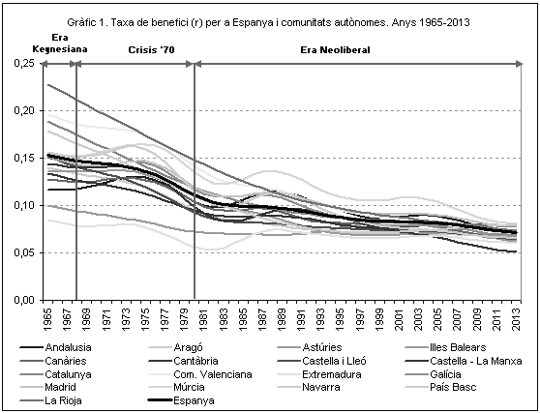
The profile of rate of profit: DECREASING
Based on the concepts expounded, and using the BdMores base for economic analysis as we propose, two determining graphs have been drawn up with one objective:
Observing resilience linked to the evolution of the rate of profit based on identifying the crisis periods of the Spanish economy throughout the period 1965-2013.
One can see a common, decreasing pattern of the profit rates from the end of the Keynesian regulation phase until the neo-liberal phase a process already detected for the United States and the big European economies in other research projects

Slide 7
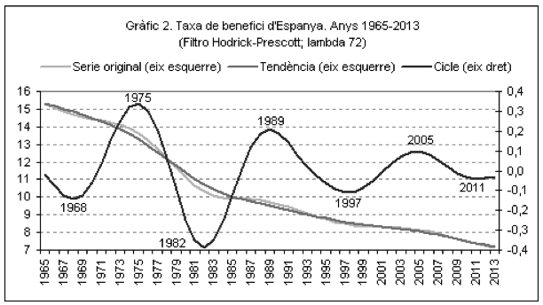
Periods
In this context, it is interesting to specify the recessive or crisis phases, which limit the timeline. In order to develop the cycle-trend analyses applied to the original series of the rate of profit of the Spanish economy, the Hodrick-Prescott filter has been used and cycle represented in graph 2 were obtained, enabling one to identify six periods:
Three of economic recovery (1968-1975, 1982-1989 and 1997-2005),
And three of recession and crisis (1975-1982, 1989-1997 and 2005-2011.
On the basis of this periodisation, one can define complete cycles with an average duration of 14 years, with periods of recover and of recession/crisis of 7 to 8 years.

Slide 8
Typologies of resilience
Having identified the recession periods, one can approach the regional resilience model for all of the autonomous communities. The model used to analyse the different regional typologies of resilience, based on the explanatory variables of the profit rate, is based on the classification of the modalities shown in chart.
Expressio Growth of (r)
g (π_{K}) > -g (q) > 0 A
g (π_{K}) < g (q) > 0 A
-g (π_{K}) < g (q) > 0
g (π_{K}) < -g (q) < 0
-g (π_{K}) < -g (q) < 0
-g (π_{K}) > -g (q) < 0 B
-g (π_{K}) > g (q) < 0 B
____________________________________
(A) CAPITAL EFFICIENT
(B) CAPITAL INEFFICIENT
(q): the surplus share = q=GOS/Y
(π_{K}): the productivity of capital = π_{K}=Y/K
r = GOS/K * GOS/Y = π_{K *} q

Slide 9
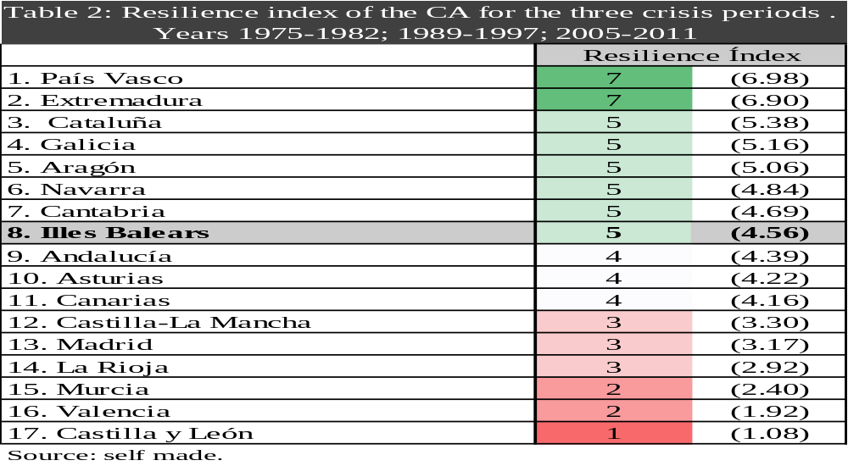
Typologies of resilience

Slide 10
CONCLUSIONS (1)
1. The regional typologies defined imply that, in terms of resilience, it is important to maintain or consolidate a certain industrial base. The paradigmatic case of this affirmation is the Basque Country, which is the region that presents the highest SRI. It also enables one to explain the good behaviour of Catalonia; and that of the “successful new industrialisations”, such as Galicia, Aragon and Navarre.
2. By contrast, there also seems to be another possible line of resilient specialisation: communities with more intense specialisation in tourism, which has enabled them to compensate their high level of deindustrialisation, for example the Balearic Islands, Andalusia and the Canary Islands.

Slide 11
CONCLUSIONS (2)
3. Cantabria and Asturias are also in this intermediate situation, for a path of resistance to significant deindustrialisation processes, in part due to the contribution by the European cohesion fund and without heading towards an intense specialisation in tourism.
4. We find the regions of “new, unconsolidated industrialisation”, i.e. Castilla-La Mancha, La Rioja and Castile and León; or those with an intense, unsuccessful specialisation in tourism, which is the case of Murcia.

Slide 12
CONCLUSIONS (3)
5. Finally, three singularities:
Madrid, because of the effect of being a capital and which, in terms of public employment.
Extremadura, due to the excessively weighty role the gross operating surpluses of the energy sector play in its economy, its SRI result is overestimated.
And Valencia, which appears to represent a failed path in terms of the consolidation of a certain industrial and tourism-oriented specialisation. Effect of a greater percentage of informal economy,
In short, this methodology, which emphasizes the importance of the profit rate and the productivity of capital, can provide a complementary vision – and even a ground-breaking one – as regards the economic evolution of the autonomous communities.
The relevance of the model presented is that it can be applied to different economic realities, with a disparate format and different structures, as long as one has the suitable statistical materials to process it.

Slide 13
THANKS FOR YOUR ATTENTION

